Slide 1

PROJECT 2
Topic: Build an online pet shop
Tuttor: Huynh Ngoc Tho
Member:
Do Ngoc Thanh
Phan Van Quoc Tuan

Slide 2
Table of content
Introduction
Analysis and design
Deployment
Summary

Slide 3

1. Introduction

Slide 4

Reason to choose the topic
1. Pet has become a trend
2. Meet the demand for buying and selling pet products

Slide 5
Purpose
Meet the growing needs of the society
Promote the development of online sales.
Shop management become easy
Easy to acess for customer

Slide 6

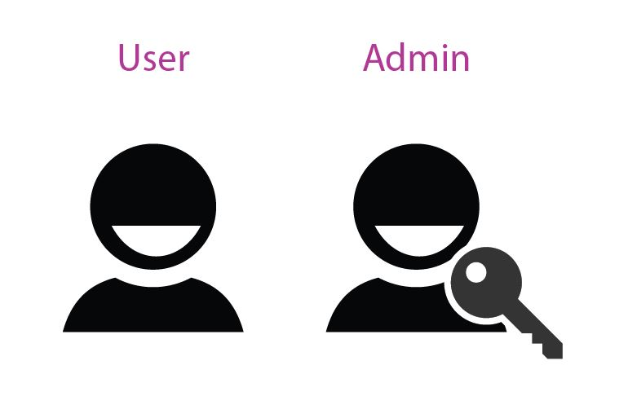
Range and Object
Range
Object

Slide 7
2. Analysis and design

Slide 8







Analysis topic
Website selling pet products
Dynamic website
View, search, buy product
Preview selected product and change in cart
Order product, chose delivery and payment method
See order process
View blog, news

Slide 9
Specification required
Admin management
User Interface
Admin manages all activities of the store.
Manage payment transactions, purchase, process orders.
Manage invoices: when buying, customers will have purchase invoices including the customer's name, receiver's address, order date, ...
Simple and harmony interface
Optimize speed
Compatible with all device
Easy to access

Slide 10
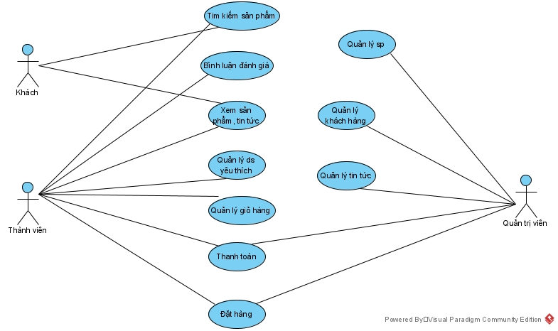
General usecase diagram

Slide 11
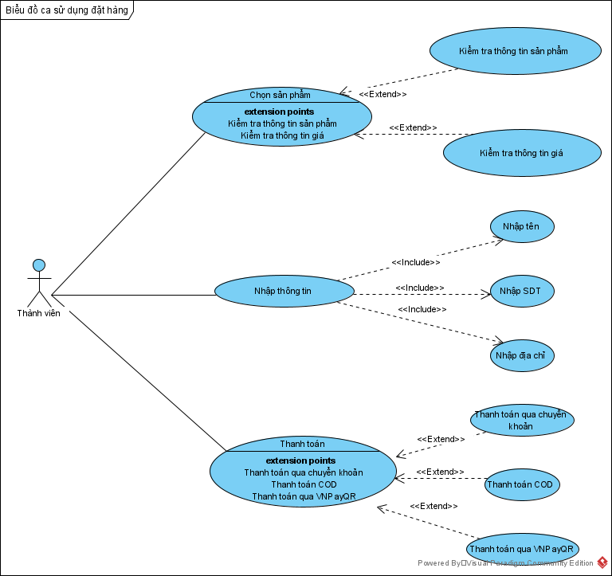
Order usecase diagram

Slide 12
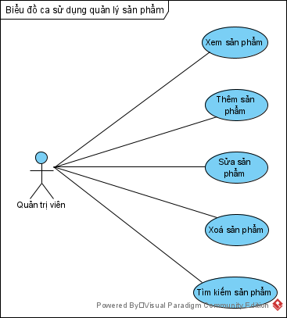
Product management usecase diagram

Slide 13
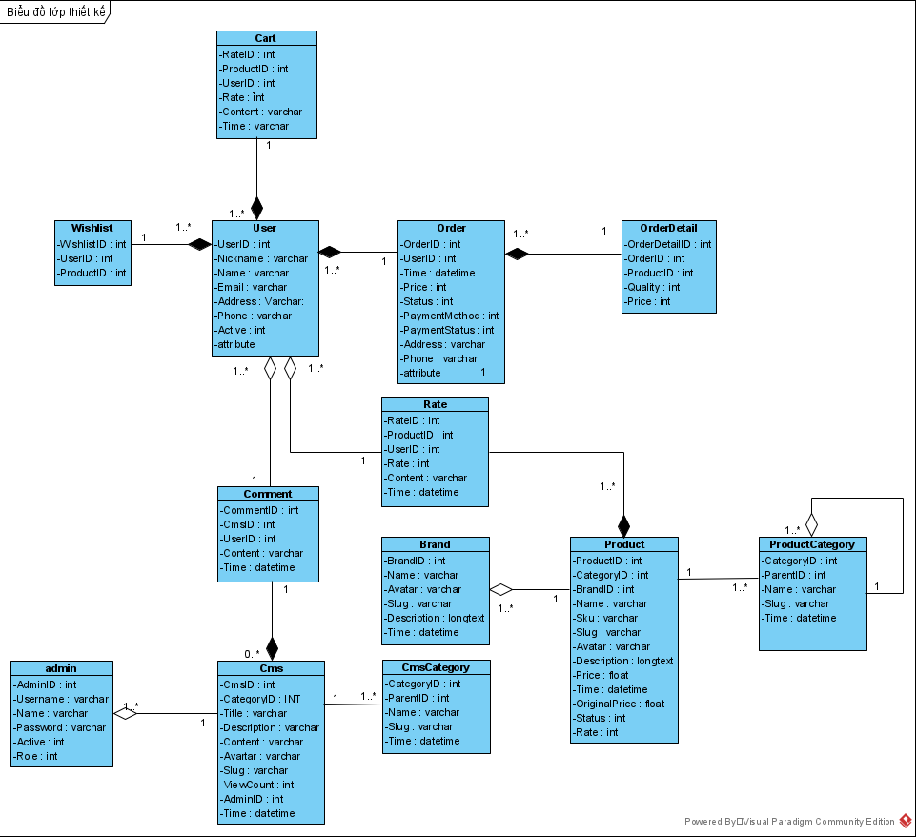
Class diagram

Slide 14
3. Deployment and result

Slide 15


Choose the solution
Language and DBMS
Framework

Slide 16
4. Summary

Slide 17
Achievement and limitation
Achievement
Limitations
Research the pet store sales business
Learn how to create dynamic website with MVC model
Intergrate speech recognition
Ajax not using widely in Admin Cpanel
User experience is not really good

Slide 18
Development
Learn more about Html, Css, JavaScript to complete more about the user interface.
Research more about user experience to arrange more reasonable and user-friendly interfaces
Develop a product suggestion system using AI
Research to integrate website with purchase application on mobile devices running Android and iOS operating systems (Similar to Shoppe, Tiki, Lazada...

Slide 19
Thanks for watching!

